Slide 1
Flooding Youth Futures
”Merusak Masa Depan Pemuda"

Slide 2
Latar Belakang Proyek Penelitian
Proyek "Flooding Youth Futures: Australian and Indonesian Climate Change Adaptation Stories" adalah hasil kerjasama antara Creative Digital English, BINUS University dan School of Languages and Cultures, University of Queensland (UQ). Proyek ini bertujuan untuk mengeksplorasi dan berbagi cerita serta pengalaman adaptasi perubahan iklim dari perspektif pemuda di Australia dan Indonesia.
Proyek "Flooding Youth Futures: Australian and Indonesian Climate Change Adaptation Stories" ini didanai oleh hibah dari Australian Indonesian Institute (AII), yang berada di bawah Kementerian Dalam Negeri Australia (DFAT).

Slide 3
Creative Digital English BINUS UNIVERSITY
Perubahan Name Program – English Department/ Sastra Inggris
The Creative Digital English program is an interdisciplinary major that merges the study of English language, literature, linguistics, culture, and creative writing with a strong emphasis on digital communication, media, and technology.

Slide 4
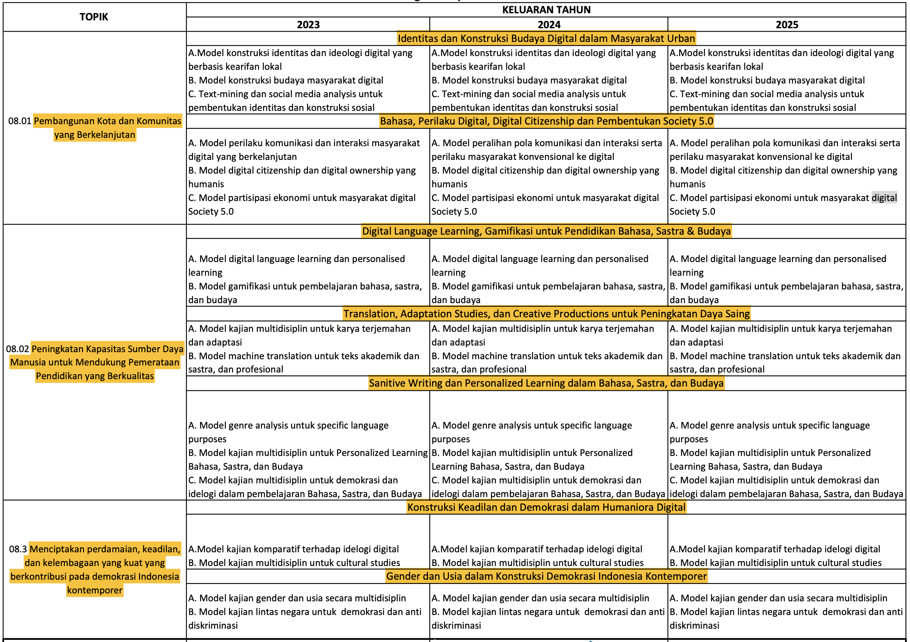
Research Roadmap – Creative Digital English

Slide 5
Flooding Youth Futures
Model Kerjasama Internasional – Tri Dharma Perguruan Tinggi
Kolaborasi Penelitian Internasional
Publikasi Bersama
Pengabdian Pada Masyarakat
Pengembangan Materi Pembelajaran BIPA (Community Development – Digital Content)
Pengajaran
Program Enrichment - Research Track (Publikasi Mahasiswa dan Research Training)

Slide 6
Kolaborasi Penelitian Internasional – Publikasi Bersama
Topik Besar:
Bagaimana banjir dan dampaknya dikomunikasikan kepada berbagai pemangku kepentingan dan dengan dampak apa
Publikasi:
Representing the voices of those living with seawater incursion in Indonesia (Book Chapter)
Creating common knowledge about the causes of tidal flooding in Kendal Regency, Indonesia (Journal Signs and Society)
Communicating “responsibly”: Provincial government communications about the causes of tidal flooding in Indonesia (Language in Society)

Slide 7
Pengabdian Kepada Masyrakat
Pembuatan Materi Pengajaran BIPA
Community Development – Digital Content
Memberikan kesadaran kepada masyarakat luas mengenai dampak banjir
https://languages-cultures.uq.edu.au/communicating-flooding
Memberikan suara kepada pemuda-pemudi di Indonesia dan Australia tentang pengalaman mereka terdampak banjir
YouTube Channel

Slide 8
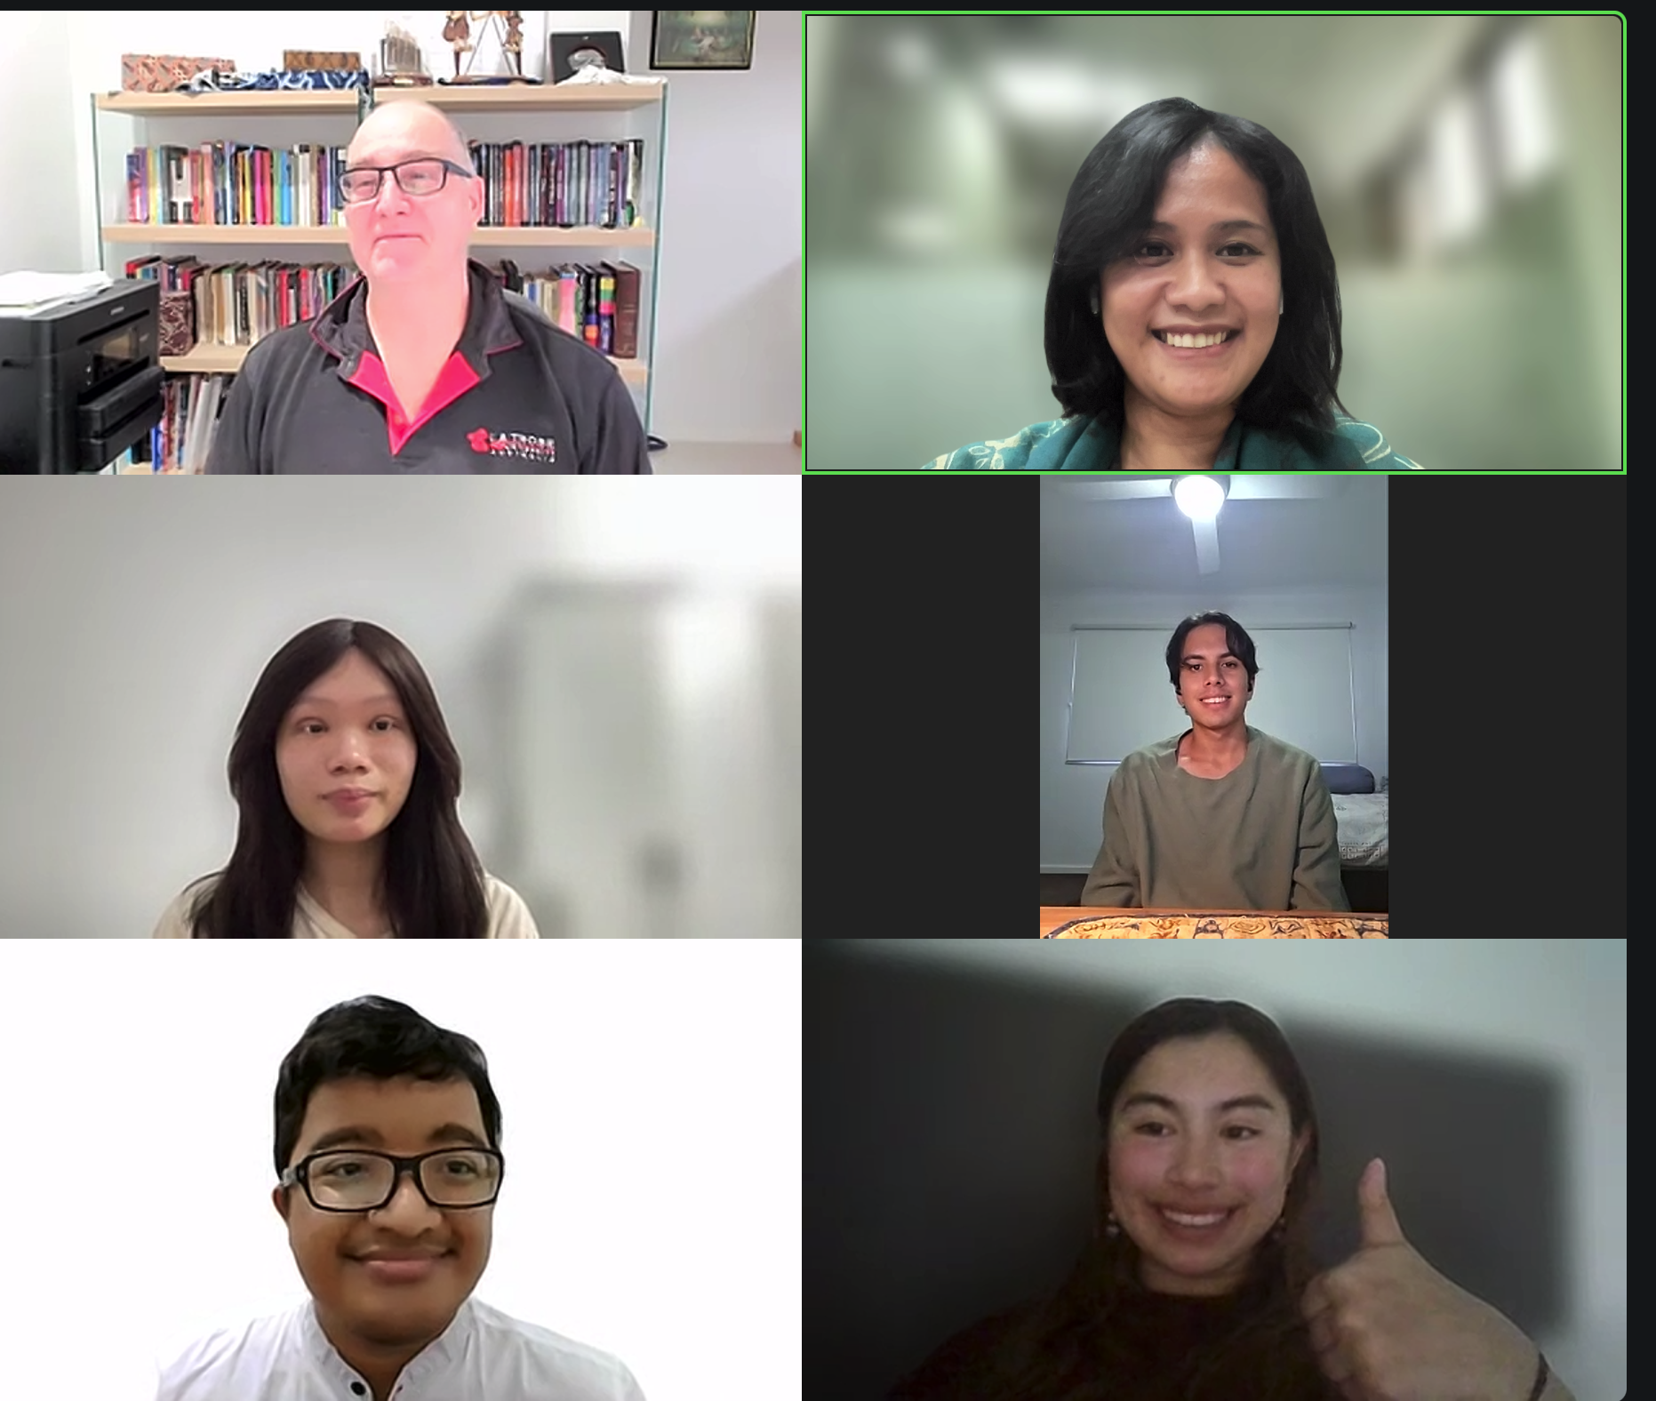
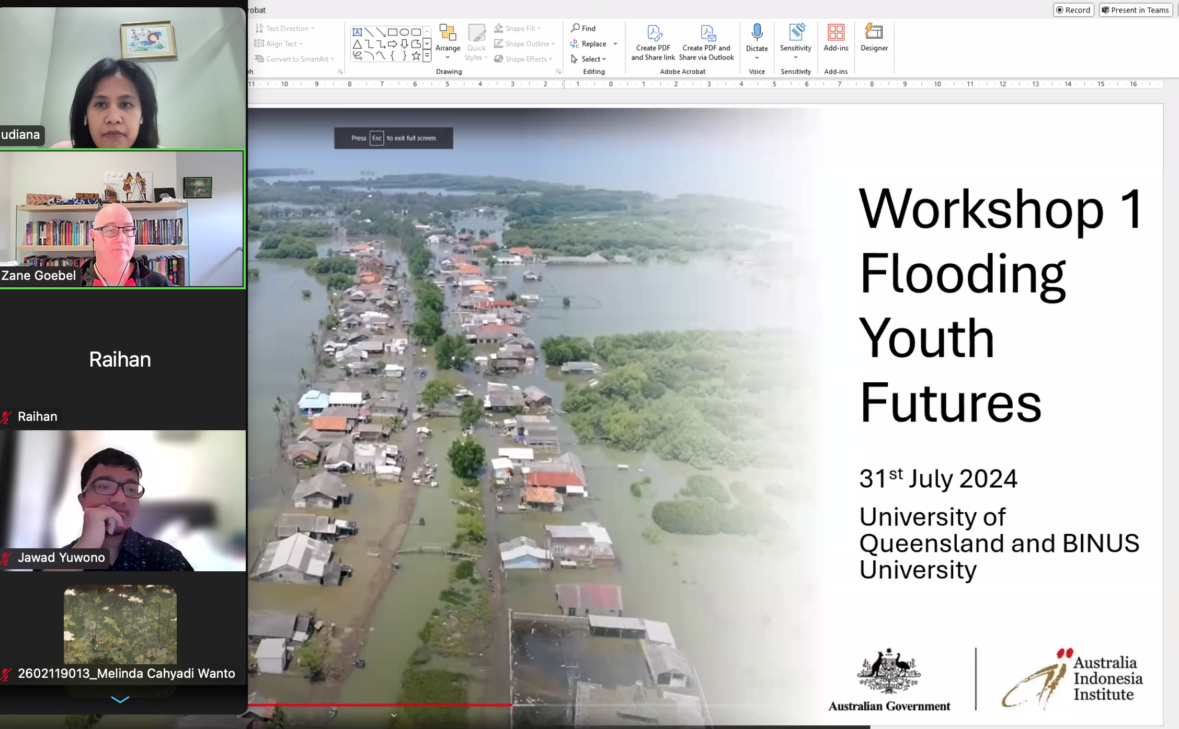
Pengajaran - Program Enrichment - Research Track (Publikasi Mahasiswa dan Research Training)

Slide 9
TERIMAKASIH

Slide 10
Brainstorm and Sharing Session
Please, make a group of 7 or 8 people.
Introduce yourself to each other in the group
Discuss and take a notes (30 minutes):
Your experience with flooding
What you think might be a potential solution
Where do you think we can find the money/funding to implement the solution
Within your group decide two/three best solutions in the group with justification why it is the best
Next session (after lunch) – Each group will be invited to share the result of their discussion and their two/three best solutions together with the justification

